Slide 1
ADVANCED DATA STRUCTURES
By
Sr. Asst.Prof. S Neelima
Dept of Information Technology
Aditya Engineering College(A)
Surampalem.

Slide 2
UNIT-II

Slide 3
Priority Queues
Apriority queue is a data structure in which each element is assigned a priority.
The priority of the element will be used to determine the order in which the elements will be processed.
The general rules of processing the elements of a priority queue are
An element with higher priority is processed before an element with a lower priority.
Two elements with the same priority are processed on a first-come-first-served (FCFS) basis.

Slide 4
Priority Queue - PQ is a queue that is ordered by priority
• Priority Queues have the following functions associated with them: –
Initialize PQ to be empty
Test whether PQ is empty
Test whether PQ is full
Insert a new item into the PQ
Delete item of highest priority

Slide 5
• There are many ways to implement PQ’s.
If we use an array, we can just insert any item into the PQ at the end.
Then a delete will need to search the entire array to find the highest priority item.
Cost: Insert: O(1), Delete: O(N).
• If we do inserts into the array to preserve priority ordering, we will need to:
Find the spot in the array where the new insertion occurs
Shuffle all the array elements to adjust the array for the new element
Cost of an insert is now O(N) - we may have to shuffle all the elements if insertion is at beginning of array.
Delete is now O(1) since the first element in the array is the highest priority item
• The same analysis applies if we use a linked list, sorted by priority. Insertion will be O(N) and deletion O(1).

Slide 6
Our goal is to find an implementation that guarantees better than O(N) performance. This is where the heap data structure comes in
A Heap is a complete binary tree with values stored in its nodes such that no child has a value smaller then the value of its parent. Put another way, every node has a smaller value than its children.
Binary heap has 2 types: min-heap and max-heap.

Slide 7
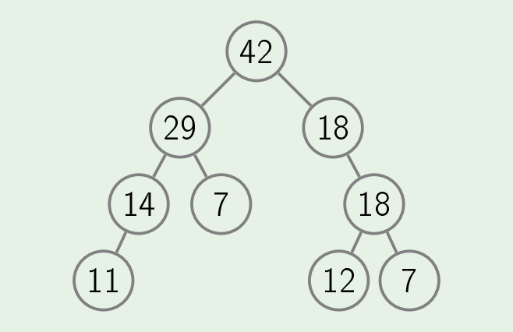
Max-heap: Binary max-heap is a binary tree(each node has zero, one or two children) where the value of each node is at least the values of its children.

Slide 8
Max-Heap has some basic operations:
GetMax: just return the root value. Cost O(1).
Insert: We will attach a new node to any leaf. If it violate the heap property, we will bubble up(called SiftUp) new node until the heap property is satisfied.

Slide 9
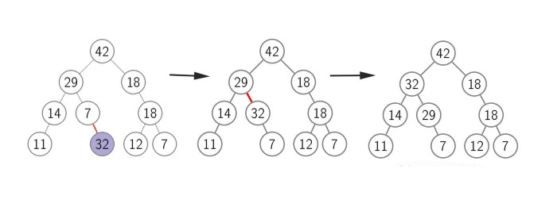
As you see, we attach new node 32 to node 7, and we bubble it to node 29.

Slide 10
ExtractMax: Root node R is the max value of max-heap. To pop out the root node, we just swap root node R to any leaf node A and remove node R. It may violate the property of heap. We will do SiftDown operation. As a parent node A, we want to SiftDown to children B and C, we will choose the max value of children B and C, and swap it to node A. We SiftDown until the property of heap is satisfied.

Slide 11
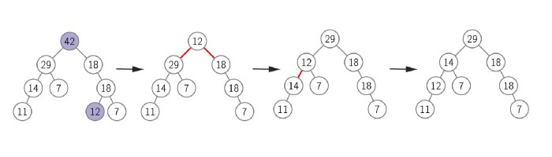
We swap root node 42 and random leaf node 12 first, and remove node 42. The max-heap is violated now, we need to sift down node 12 as root down to children. At the final step, we have node 29 is root node.

Slide 12
ChangePriority: We need to change priority of a node. Depend on the value of new priority we will do SiftDown or SiftUp to qualify the heap property.
Remove: To remove a node A. We do it by 2 steps:
Step 1: Make that value of node A becomes biggest(infinity). We will do SiftUp operation to make node A become a root node.
Step 2: We do ExtractMax operation that describes above.

Slide 13
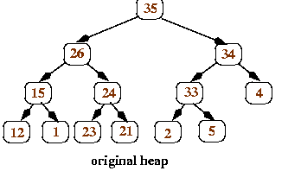
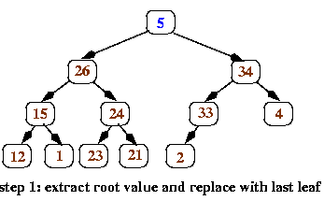
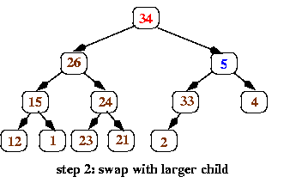
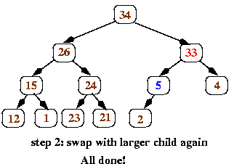

Slide 14
Building Heap
We know how heap works, we need to find out the way to build a heap. To build a heap and keep a binary heap-tree shallows, we have to fill the new node from left to right on last level. It’s called complete binary tree. Formally:
A binary tree is complete if all its levels are filled except possibly the last one which is filled from left to right.

Slide 15
How to build the heap?
Heapify procedure can be applied to a node only if its children nodes are heapified. So the heapification must be performed in the bottom-up order.
Lets understand with the help of an example:
Input data: 4, 10, 3, 5, 1
4
/ \
10 3
/ \
5 1

Slide 16
The numbers in bracket represent the indices in the array representation of data.
Applying heapify procedure to index 1:
10(0)
/ \
4 (1) 3(2)
/ \
5(3) 1(4)

Slide 17
Applying heapify procedure to index 0:
10(0)
/ \
5(1) 3(2)
/ \
4(3) 1(4)
The heapify procedure calls itself recursively to build heap in top down manner.

Slide 18
Applications of Priority Queue
Prim's algorithm implementation can be done using priority queues.
Dijkstra's shortest path algorithm implementation can be done using priority queues.
A* Search algorithm implementation can be done using priority queues.
Priority queues are used to sort heaps.
Priority queues are used in operating system for load balancing and interrupt handling.
Priority queues are used in huffman codes for data compression.
In traffic light, depending upon the traffic, the colors will be given priority.

Slide 20
Heap Sort Algorithm for sorting in increasing order:
1. Build a max heap from the input data.
2. At this point, the largest item is stored at the root of the heap. Replace it with the last item of the heap followed by reducing the size of heap by 1. Finally, heapify the root of the tree.
3. Repeat step 2 while size of heap is greater than 1.

Slide 21
Thank You

